Slide 1
Scientific Machine Learning for Modeling, Optimization, and Control
Ján Drgoňa
Associate Professor @ CaSE & ROSEI

Slide 2
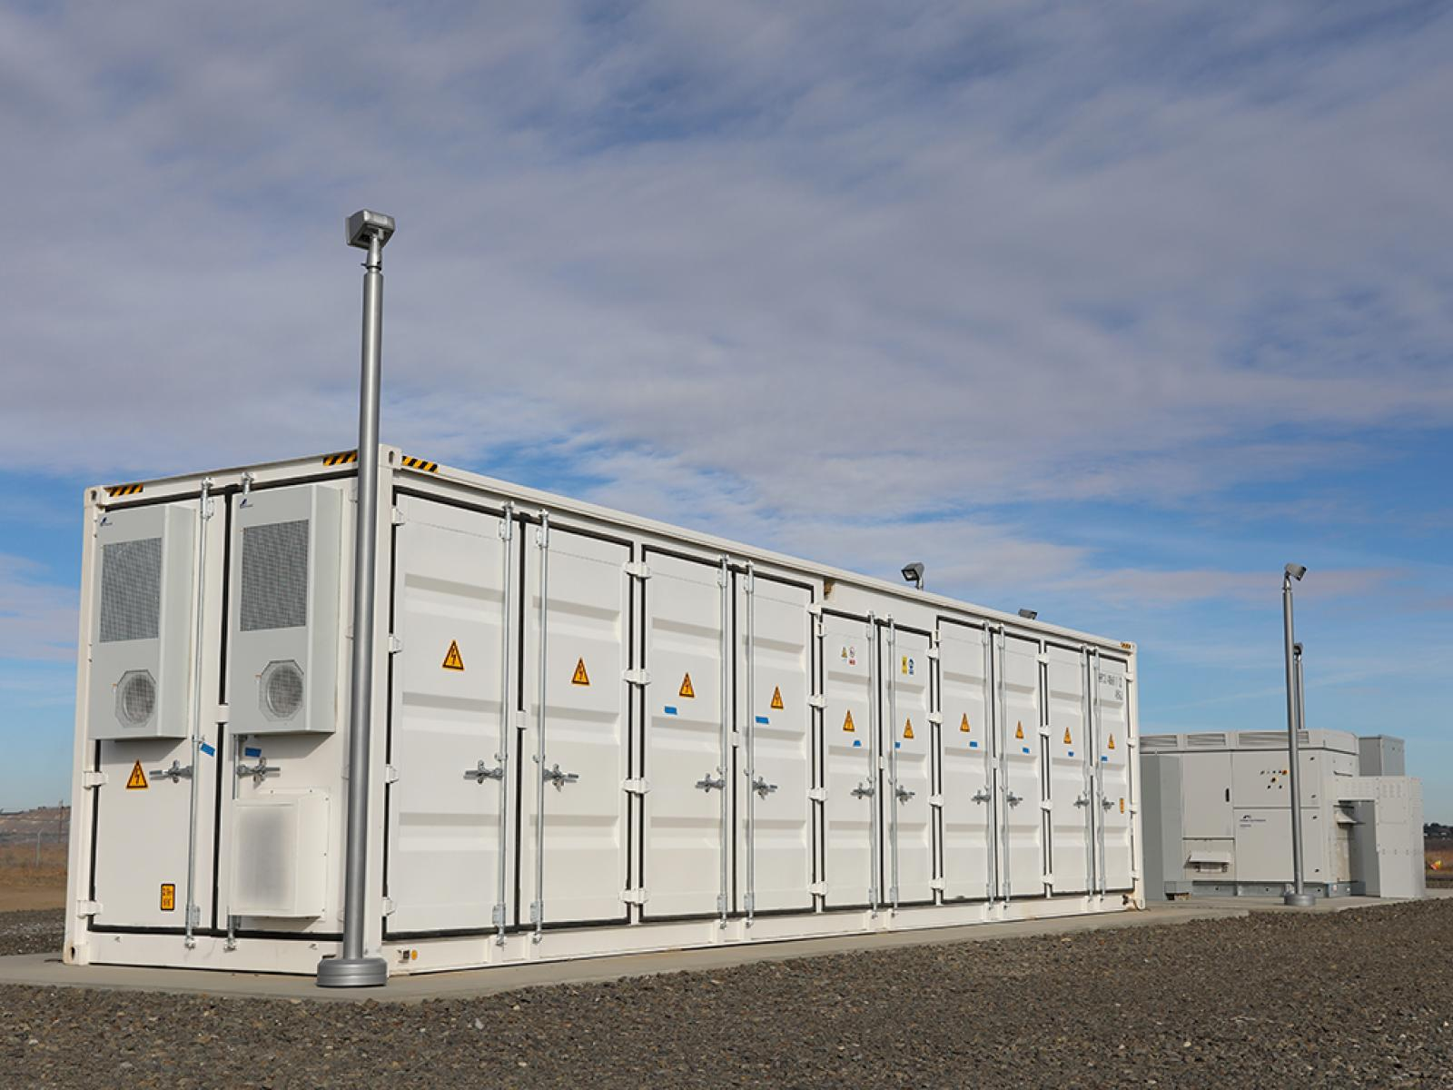

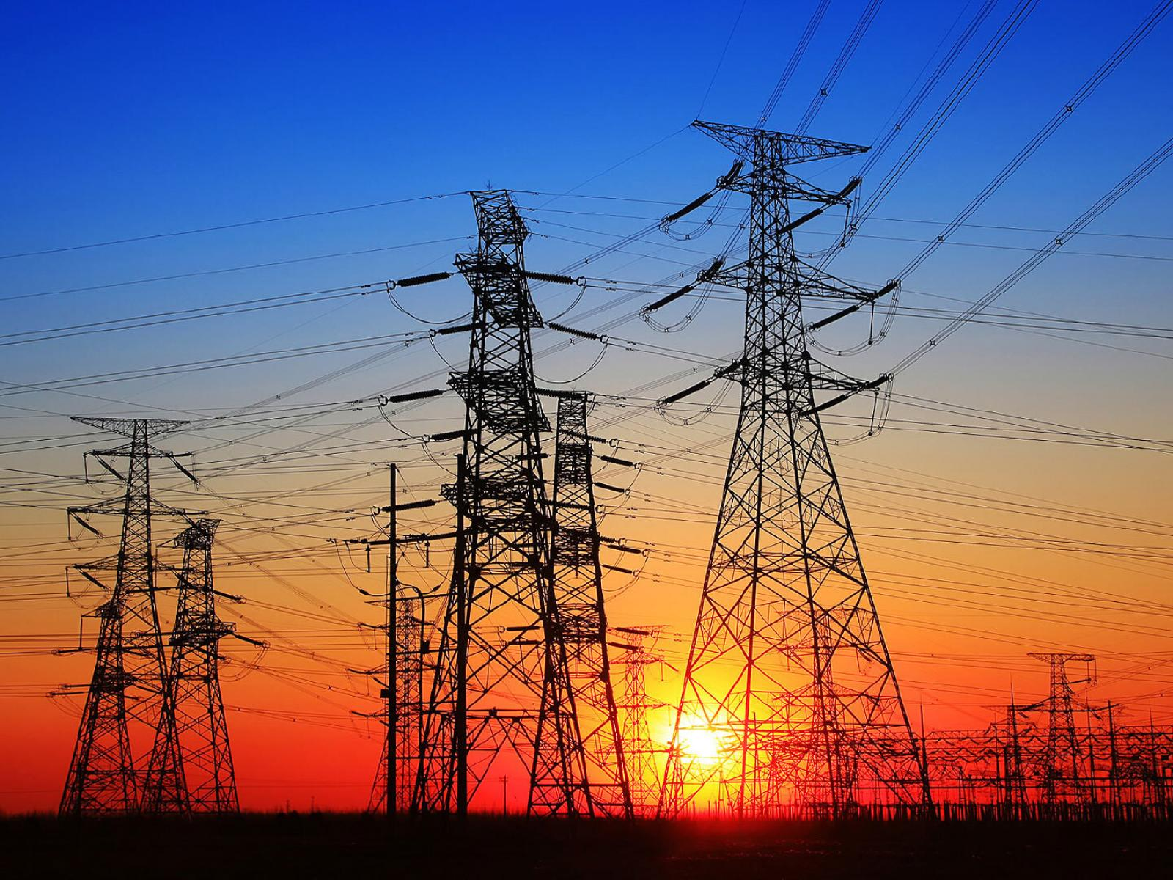

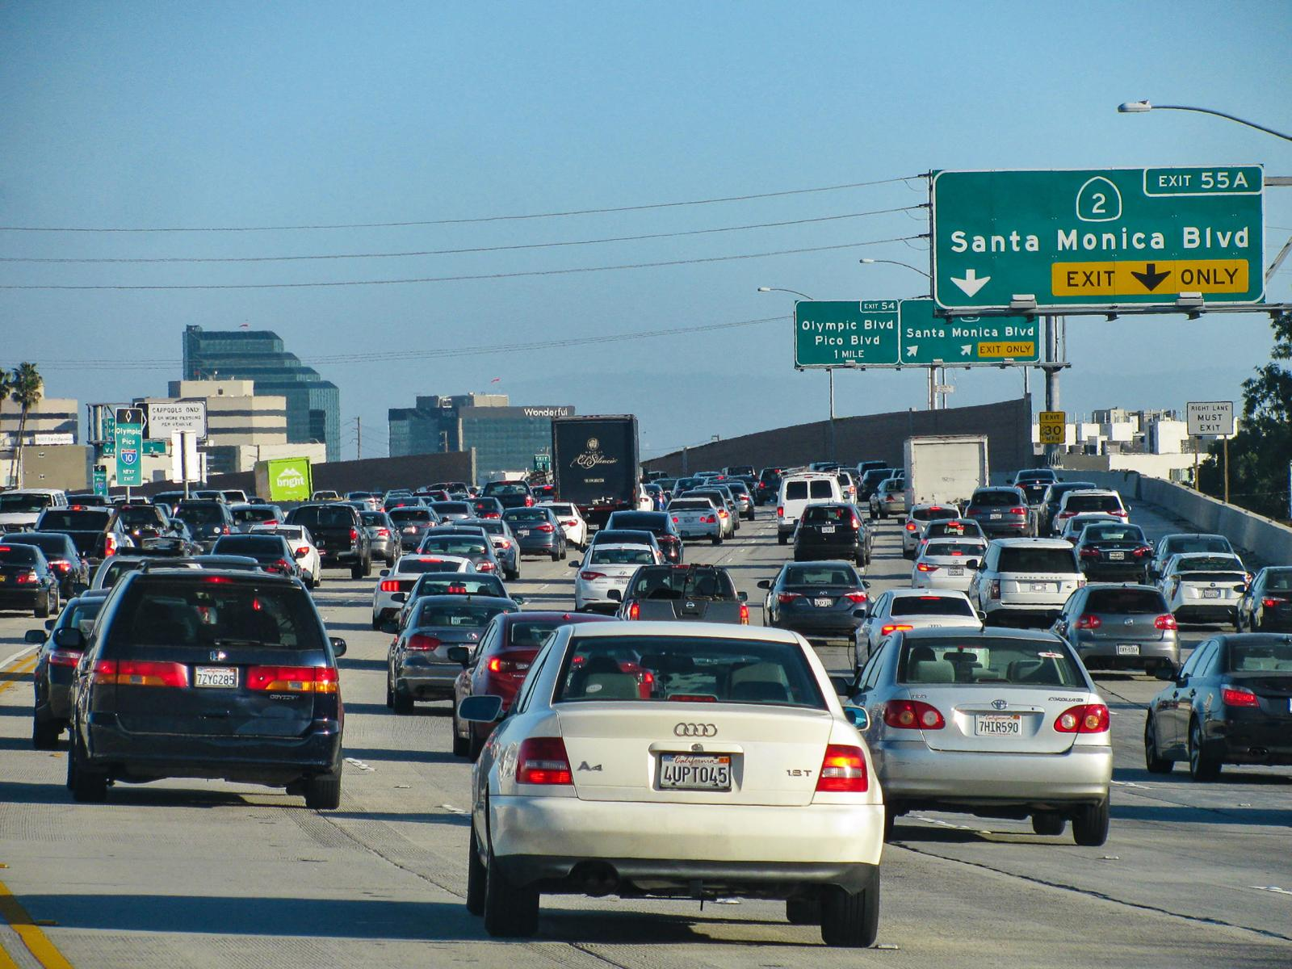
Optimizing Complex Energy Systems is Hard
Simulations are crucial for optimal decision-making in complex energy systems
Need: Improve computational efficiency and scalability of digital twins
Challenges:
Modeling and simulation of complex systems is hard
Optimal control and closed-loop decision-making for complex systems is hard-er
Scientific computing and machine learning tools are fragmented and not easily composable

Slide 3
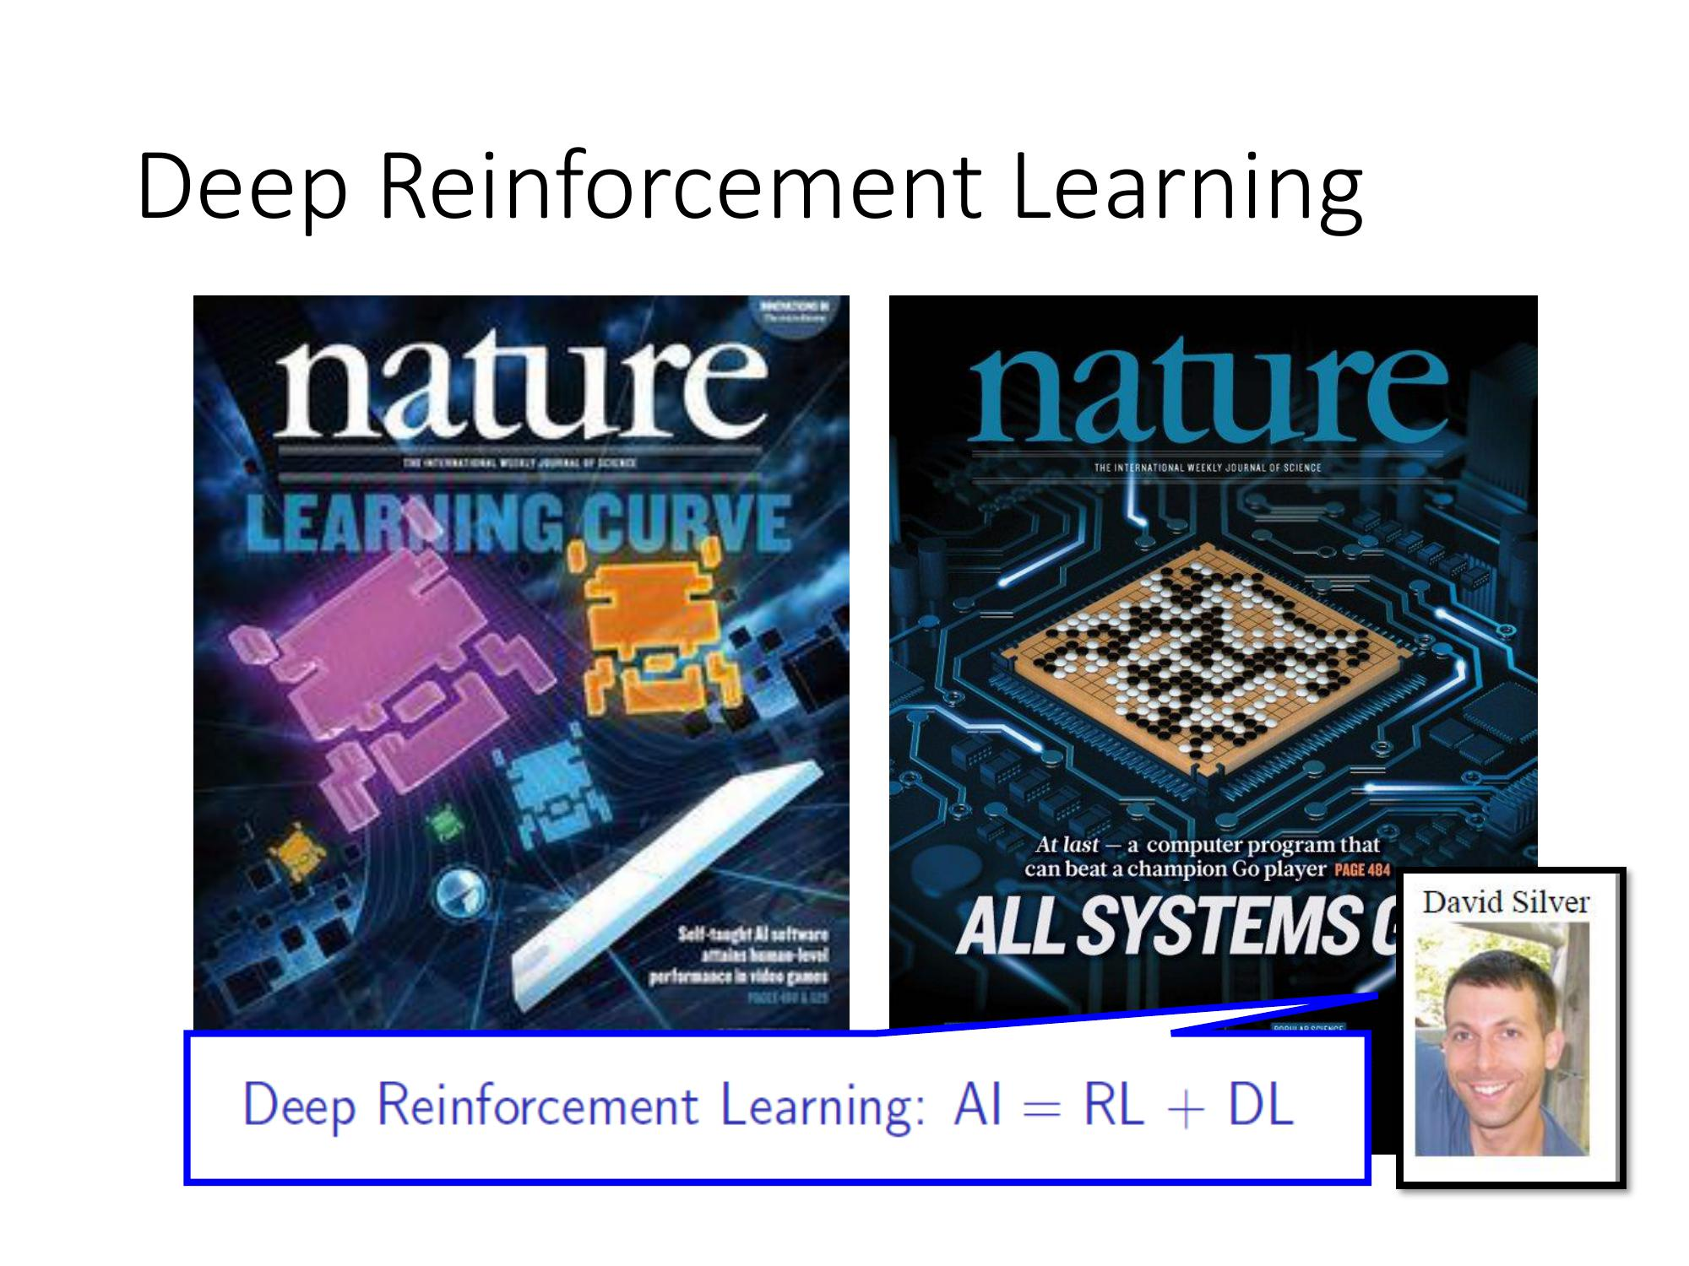

Existing Decision-Making Approaches
Model-based Optimal Control
Learning-based Optimal Control
More domain knowledge
Less domain knowledge
Drgona J., et al. "All You Need to Know About Model Predictive Control for Buildings." Annual Reviews in Control, September 29, 2020
G. Dulac-Arnold, D. J. Mankowitz, and T. Hester, “Challenges of real-world reinforcement learning,”, 2019.

Slide 4
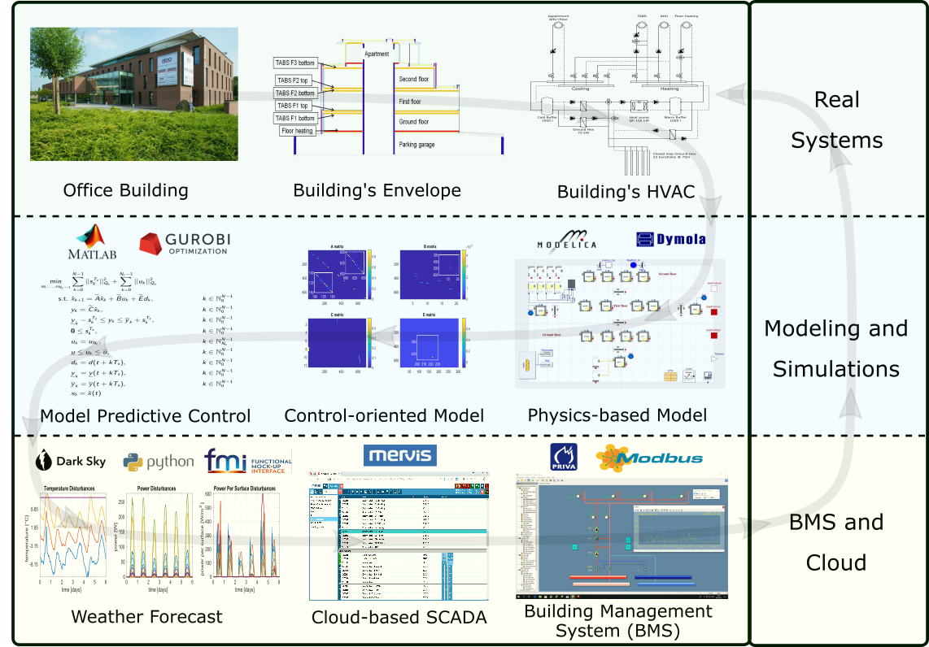
Example: Model-based Optimal Control of Building Energy Systems
Motivation
Buildings today contribute to approximately 40% of the global energy use.
Existing control solutions governing building energy systems are very inefficient.
Drgona J., et al., Cloud-based implementation of white-box model predictive control for a GEOTABS office building: a field test demonstration. Journal of Process Control, 2020.

Slide 5
Example: Model-based Optimal Control of Building Energy Systems
Upside
Heat pump energy savings up to 53%.
Improvement of thermal comfort up to 37%.
Drgona J., et al., Cloud-based implementation of white-box model predictive control for a GEOTABS office building: a field test demonstration. Journal of Process Control, 2020.

Slide 6
Example: Model-based Optimal Control of Building Energy Systems
Upside
Heat pump energy savings up to 53%.
Improvement of thermal comfort up to 37%.
Downside
Project duration: 1 year.
Expertise required: 6 staff with advanced engineering degree.
Drgona J., et al., Cloud-based implementation of white-box model predictive control for a GEOTABS office building: a field test demonstration. Journal of Process Control, 2020.

Slide 7
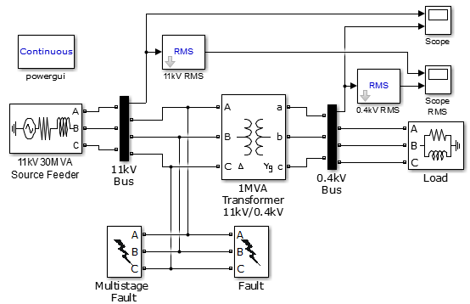
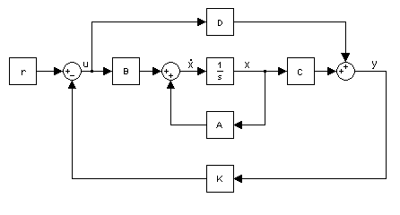

Challenge 1: Heterogenous Modeling Methods
White-box models
Gray-box models
Black-box models
Physics-based
Data-driven
More domain knowledge
Less domain knowledge

Slide 8

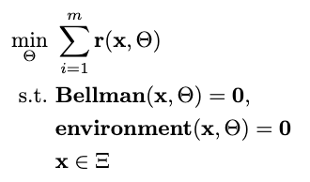

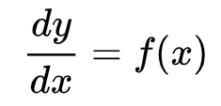

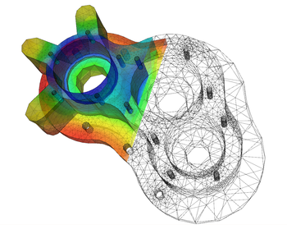
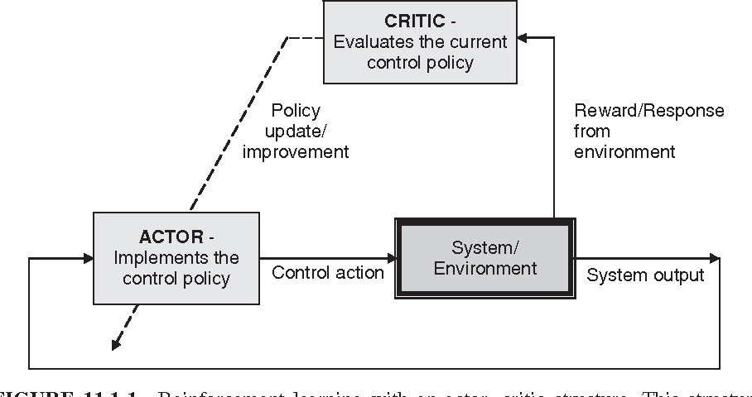

Challenge 2: Heterogenous Solution Methods
Constrained Optimization
Differential Equations
Supervised Learning
Reinforcement Learning
Requires prior knowledge of objective function and constraints
Requires prior knowledge of the physics to be modeled
Requires large labeled datasets
Requires environment model to sample
More domain knowledge
Less domain knowledge

Slide 9












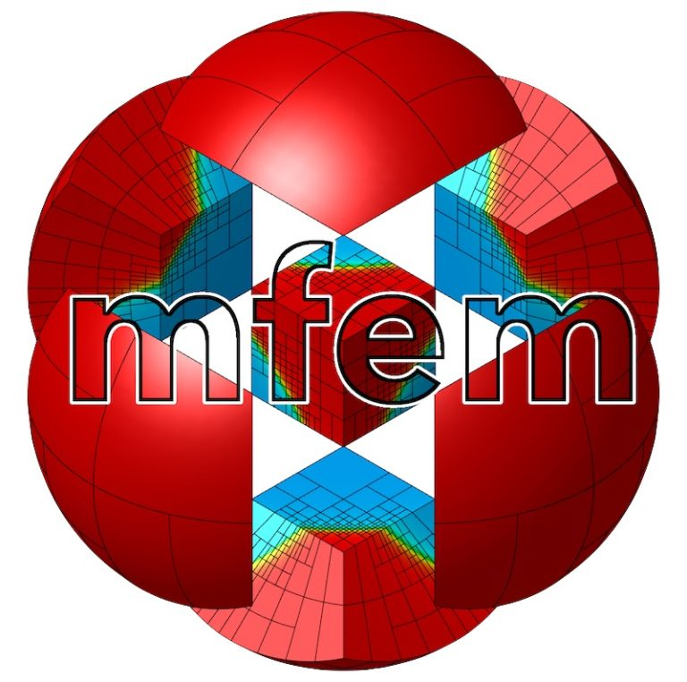



Challenge 3: Heterogenous Solution Tools
Constrained Optimization
Differential Equations
Supervised Learning
Reinforcement Learning
More domain knowledge
Less domain knowledge

Slide 10
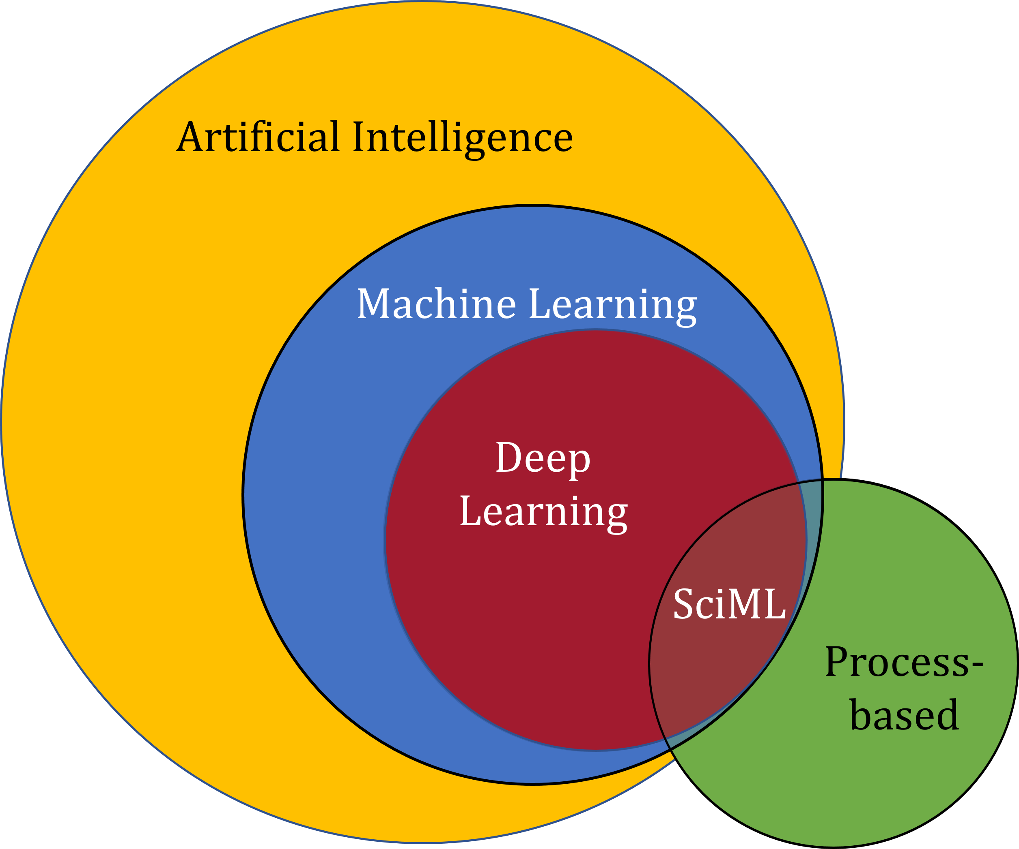
Scientific Machine Learning (SciML)
What?
SciML systematically integrates ML methods with mathematical models and algorithms developed in various scientific and engineering domains
Why?
Scientific applications are governed by fundamental principles and physical constraints
Purely data-driven “black box” ML methods cannot satisfy underlying physics
How?
Leverage automatic differentiation used in learning for modeling, optimization, and control
Karniadakis, G.E., Kevrekidis, I.G., Lu, L. et al. Physics-informed machine learning. Nat Rev Phys 3, 422–440, 2021.
Image source: https://sciml.wur.nl/reviews/sciml/sciml.html

Slide 11
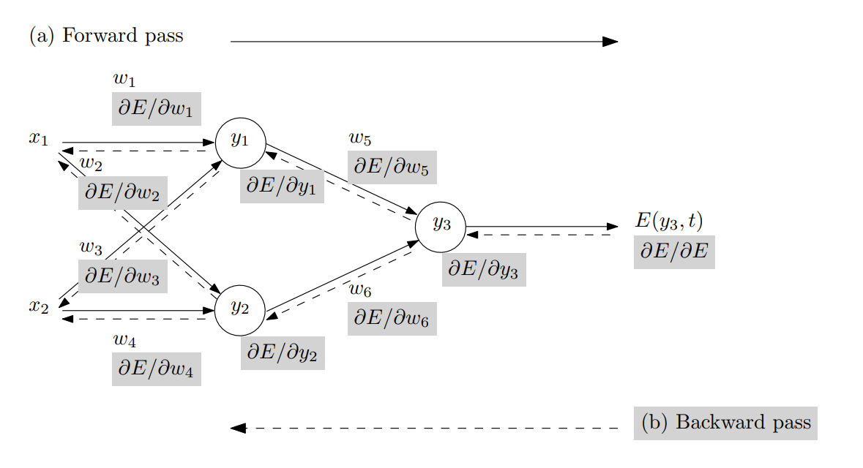
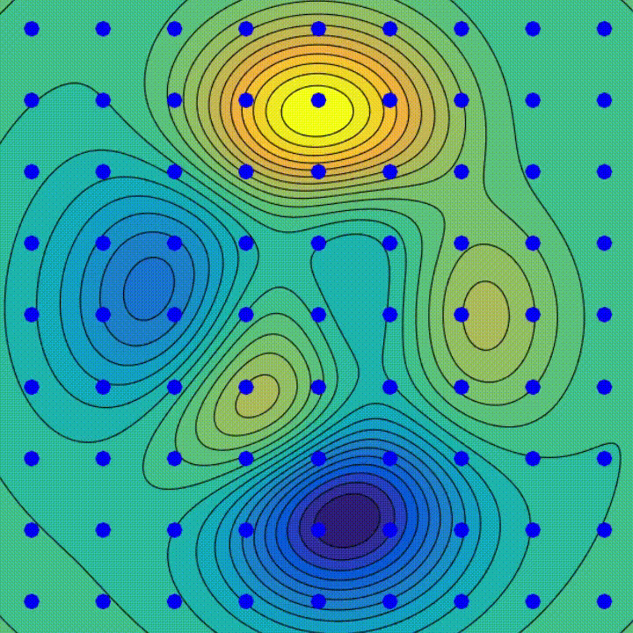
Automatic Differentiation in Machine Learning
Forward and Backward propagation
through computational graph
Gradient descent
algorithm
Animation source: wikipedia
Baydin, Atilim Gunes et al. Automatic differentiation in machine learning: a survey. Journal of Machine Learning Research, 2015

Slide 12
Selected Scientific Machine Learning Literature
Differentiable Programming
M. Innes, et al., A Differentiable Programming System to Bridge Machine Learning and Scientific Computing, 2019
Learning to Solve (L2S)
M. Raissi, et al., Physics-informed neural networks: A deep learning framework for solving forward and inverse problems involving nonlinear partial differential equations, 2019
Learning to Optimize (L2O)
A. Agrawal, et al., Differentiable Convex Optimization Layers, 2019
P. Donti, et al., DC3: A learning method for optimization with hard constraints, 2021
J. Kotary, et al., End-to-End Constrained Optimization Learning: A Survey, 2021
Learning to Model (L2M)
B. Lusch, et al., Deep learning for universal linear embeddings of nonlinear dynamics, 2018
R. T. Q. Chen, et al., Neural Ordinary Differential Equations, 2019
C. Rackauckas, et al., Universal Differential Equations for Scientific Machine Learning, 2021
Learning to Control (L2C)
B. Amos, et al., Differentiable MPC for End-to-end Planning and Control, 2019
S. East, et al., Infinite-Horizon Differentiable Model Predictive Control, 2020
Y Qiao, et al., Scalable Differentiable Physics for Learning and Control, 2020

Slide 13
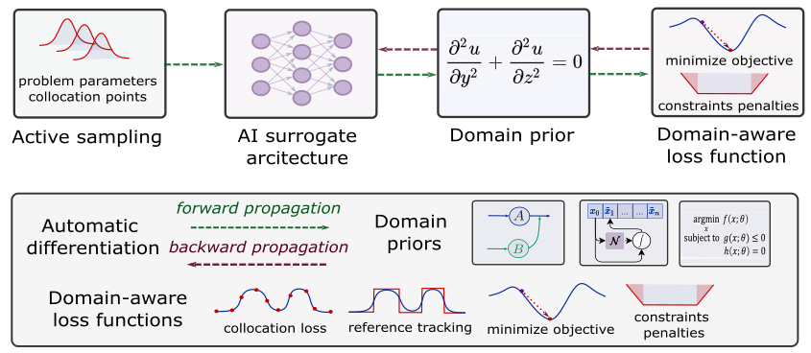
Components of Scientific Machine Learning
Karniadakis, G.E., Kevrekidis, I.G., Lu, L. et al. Physics-informed machine learning. Nat Rev Phys 3, 2021.
Thiyagalingam, J., Shankar, M., Fox, G. et al. Scientific machine learning benchmarks. Nature Reviews Physics 4, 413–420, 2022.
Nghiem T., Drgona J., et al. Physics-Informed Machine Learning for Modeling and Control of Dynamical Systems, ACC, 2023.

Slide 14

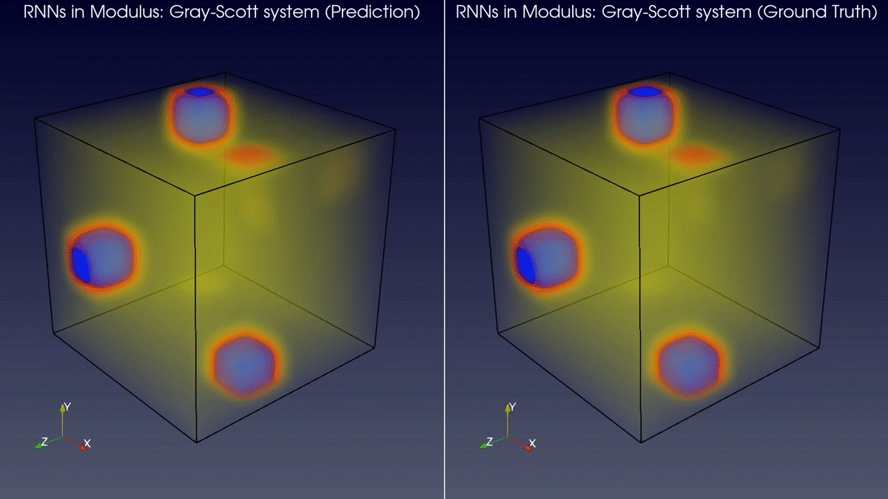
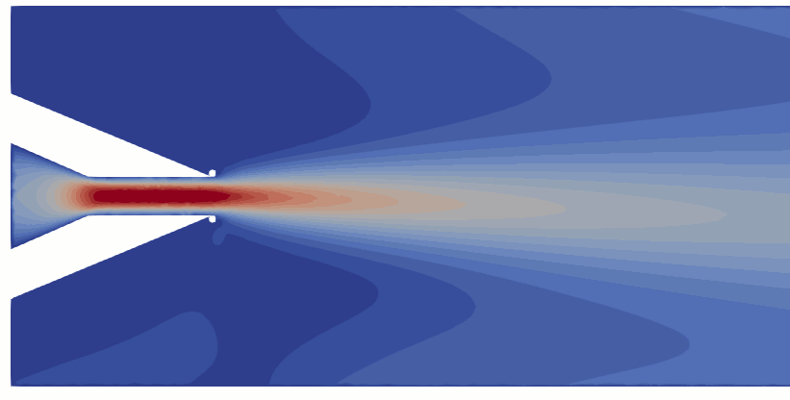
Learning to Solve Differential Equations with Physics-Informed Neural Networks (PINNs)
Training neural networks as PDE solutions
Application: Parameter estimation from data
M. Raissi, et al., Physics-informed neural networks: A deep learning framework for solving forward and inverse problems involving nonlinear partial differential equations, Journal of Computational Physics, 2019
Images: NVIDIA Modulus

Slide 15
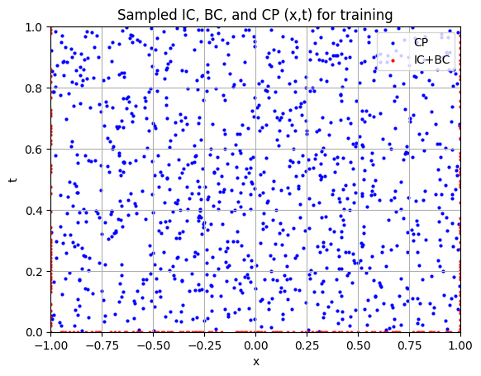
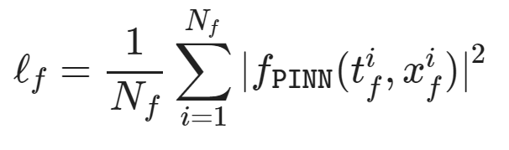
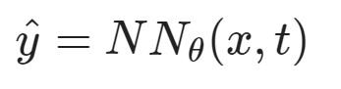
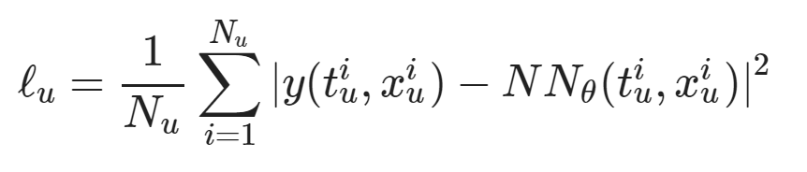
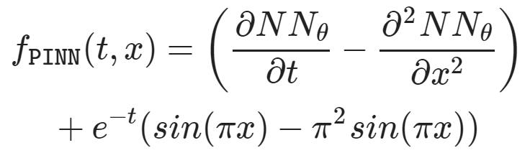
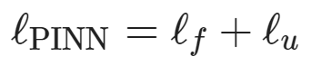
Learning to Solve Differential Equations with Physics-Informed Neural Networks (PINNs)
Dataset: collocation points in the spatio-temporal coordinates.
Architecture: PDE equations solved with neural network via automatic differentiation.
Loss function: minimizing PDE equation, initial and boundary condition residuals.
https://github.com/pnnl/neuromancer/blob/master/examples/PDEs/Part_2_PINN_BurgersEquation.ipynb
M. Raissi, et al., Physics-informed neural networks: A deep learning framework for solving forward and inverse problems involving nonlinear partial differential equations, Journal of Computational Physics, 2019

Slide 16
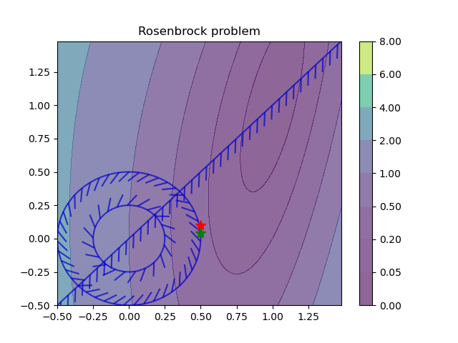
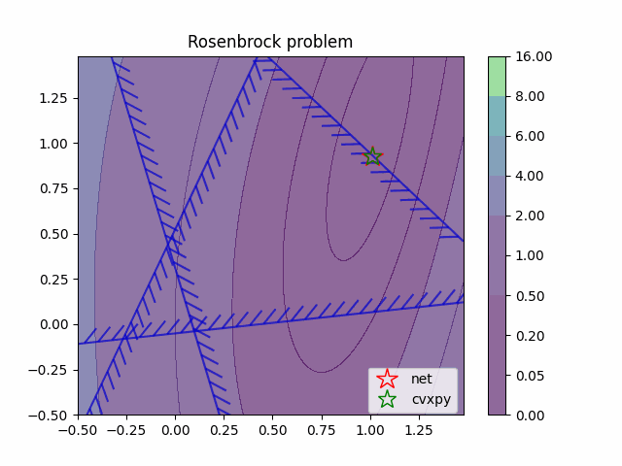
Learning to Optimize (L2O) with Constraints
Training neural networks as optimization solutions
Application: solving optimal power flow
James Kotary, et al., End-to-End Constrained Optimization Learning: A Survey, IJCAI, 2021

Slide 17
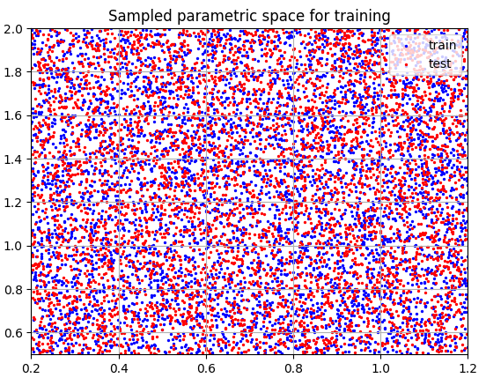
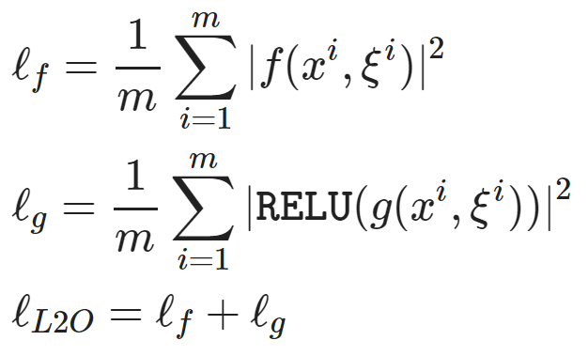
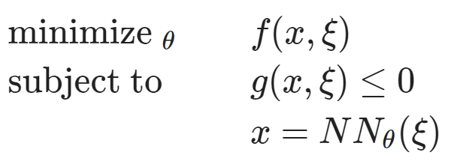
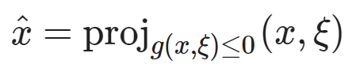
Learning to Optimize (L2O) with Constraints
Dataset: collocation points in the parametric space.
Architecture: differentiable optimization solver with neural network surrogate.
Loss function: minimizing objective function and constraints penalties.
https://github.com/pnnl/neuromancer/blob/master/examples/parametric_programming/Part_1_basics.ipynb
A. Agrawal, et al., Differentiable Convex Optimization Layers, 2019
P. Donti, et al., DC3: A learning method for optimization with hard constraints, 2021

Slide 18
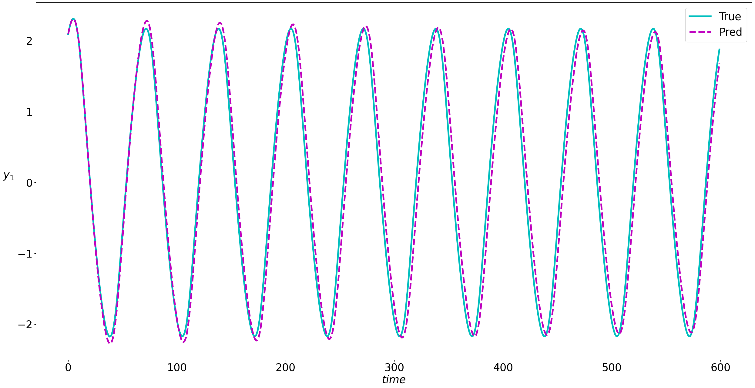
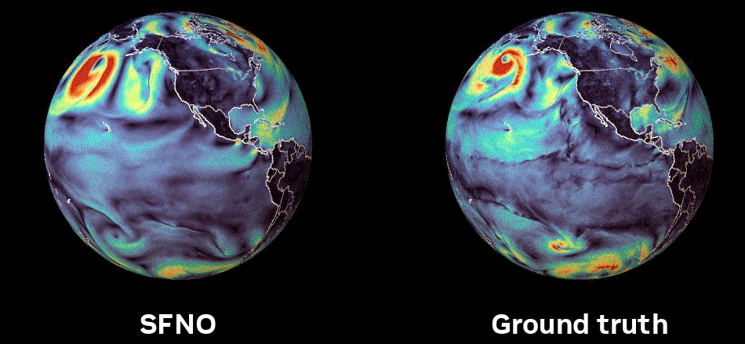
Learning to Model (L2M) Dynamical Systems
Neural models for nonlinear system identification
Application: climate modeling
R. T. Q. Chen, et al., Neural ordinary differential equations. NeurIPS, 2018
C. Rackauckas, et al., Universal Differential Equations for Scientific Machine Learning, 2021
Image: NVIDIA FourCastNet

Slide 19
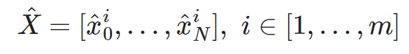
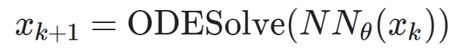
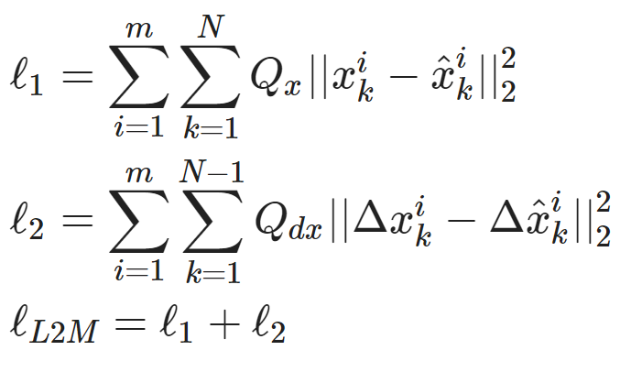
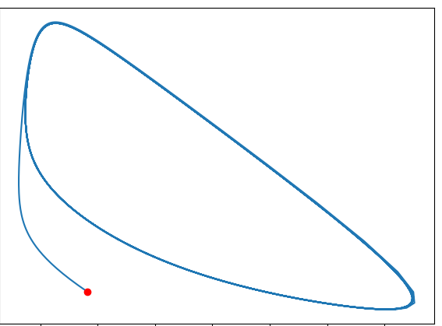
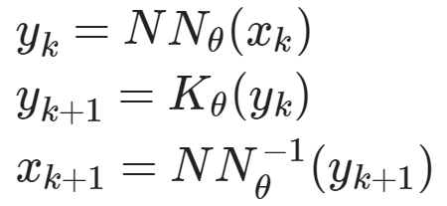
Learning to Model (L2M) Dynamical Systems
Dataset: time-series of states, inputs, and disturbances tuples.
Architecture: differentiable ODE solver with neural network model.
Loss function: trajectory matching, regularizations, and constraints penalties.
Architecture: Koopman operator with neural network basis functions.
https://github.com/pnnl/neuromancer/blob/master/examples/ODEs/Part_1_NODE.ipynb
R. T. Q. Chen, et al., Neural Ordinary Differential Equations, 2019
B. Lusch, et al., Deep learning for universal linear embeddings of nonlinear dynamics, 2018

Slide 20
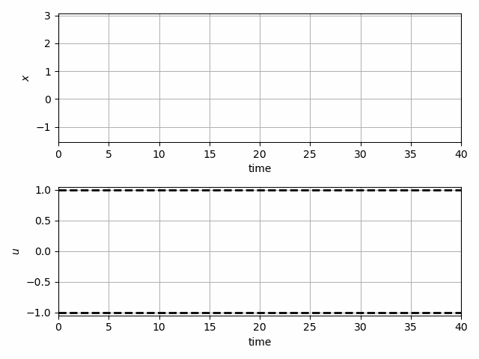
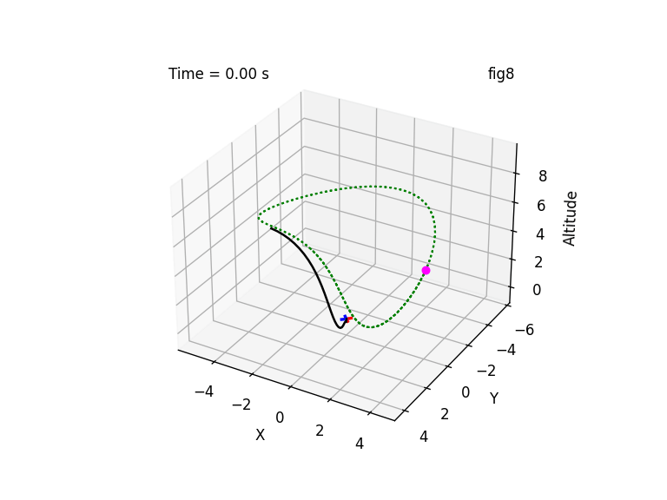
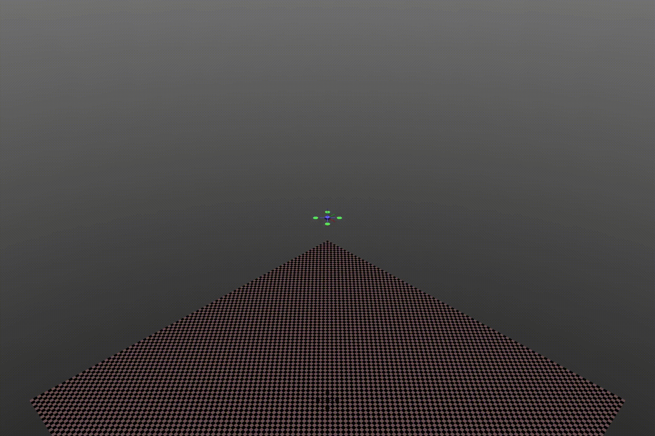
Learning to Control (L2C) with Differentiable System Models
Trajectory optimization for dynamical systems
Application: autonomous systems
J. Drgoňa, A. Tuor and D. Vrabie, "Learning Constrained Parametric Differentiable Predictive Control Policies With Guarantees," in IEEE Transactions on Systems, Man, and Cybernetics: Systems, 2024

Slide 21
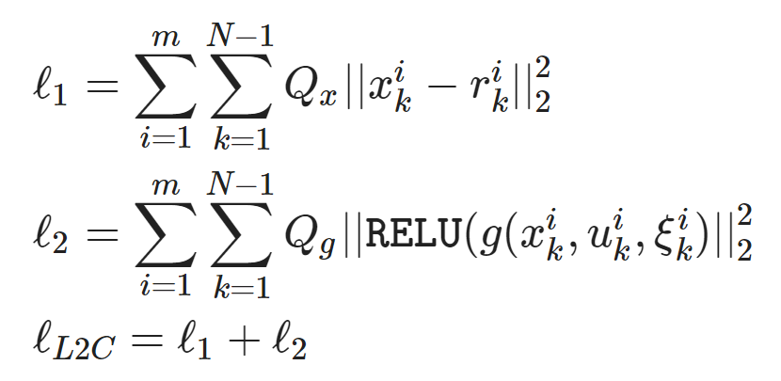
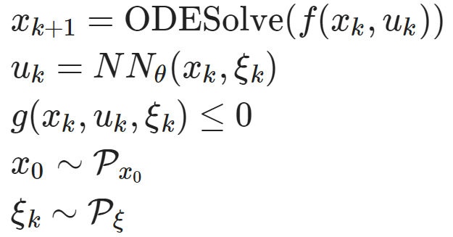
Learning to Control (L2C) with Differentiable System Models
Dataset: collocation points in the control parametric space.
Architecture: differentiable model with neural network control policy.
Loss function: reference tracking, constraints and terminal penalties.
https://github.com/pnnl/neuromancer/blob/master/examples/control/Part_3_ref_tracking_ODE.ipynb
Jan Drgona, et al., Differentiable Predictive Control: An MPC Alternative for Unknown Nonlinear Systems using Constrained Deep Learning, Journal of Process Control, 2022

Slide 22

NeuroMANCER Scientific Machine Learning Library
Open-source library in PyTorch
Physics-informed Neural Networks
Learning to optimize
Neural differential equations
Learning to control
github.com/pnnl/neuromancer

Slide 23
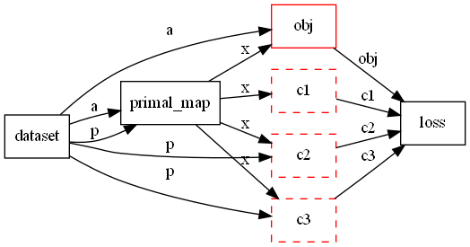
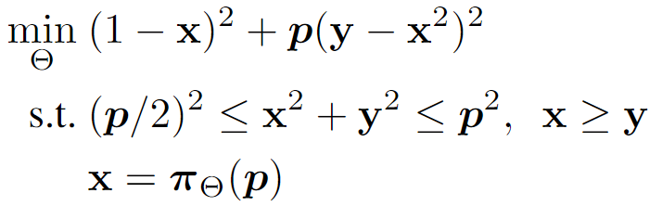
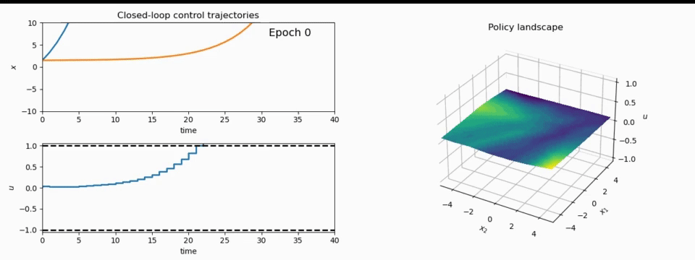
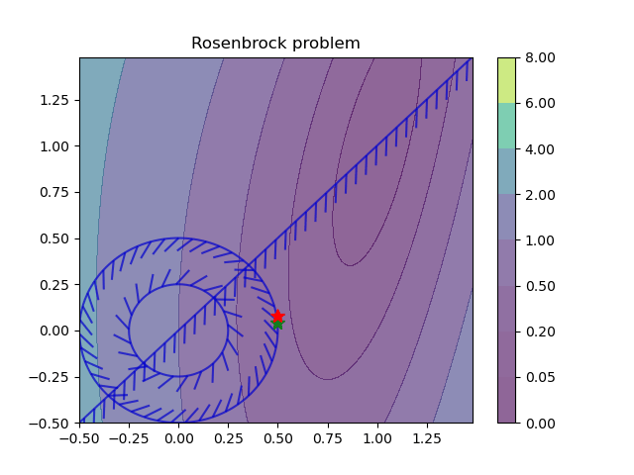
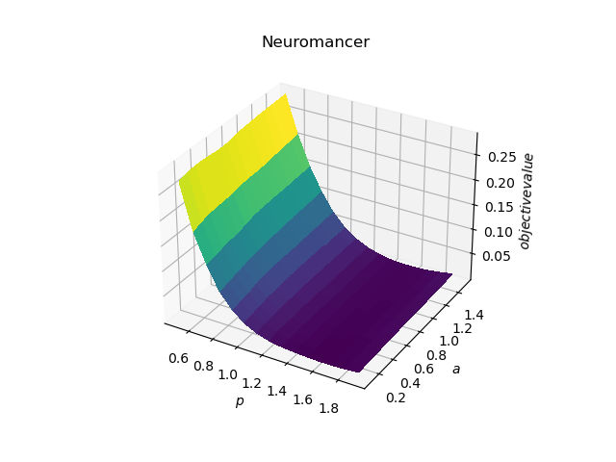
NeuroMANCER Scientific Machine Learning Library
1. Mathematical formulation
3. Problem graph
map
2. Python code interface
4. Results
import neuromancer as nm
p = nm.variable(‘p’)
x = nm.variable(‘x’)
y = nm.variable('y’)
obj = ((1-x)**2 + p*(y-x**2)**2).minimize(weight=1.0, name='obj’) c1 = (p/2)**2 <= x**2 + y**2
c2 = x**2 + y**2 <= p**2
c3 = x >= y net = nm.MLP(insize=2, outsize=2, hsizes=[80]*4) map = nm.Node(net, input_keys=['p’], output_keys=[‘x’,‘y’])
loss = nm.PenaltyLoss([obj], [c1, c2, c3]) problem = nm.Problem([map], loss)
optimizer = torch.optim.AdamW(problem.parameters()) trainer = nm.Trainer(problem,data,optimizer)
best_model = trainer.train()

Slide 24


Learning to Control Building Energy System
Benefits of Scientific Machine Learning-based Digital Twins
Modeling and optimal control design is roughly 10-times faster and requires less expertise.
Real-time decisions are made orders of magnitude faster than traditional model-based approaches.
J. Drgona, et al., Physics-constrained deep learning of multi-zone building thermal dynamics, Energy and Buildings, 2021
J. Drgona, et al., Deep Learning Explicit Differentiable Predictive Control Laws for Buildings, IFAC NMPC 2021

Slide 25
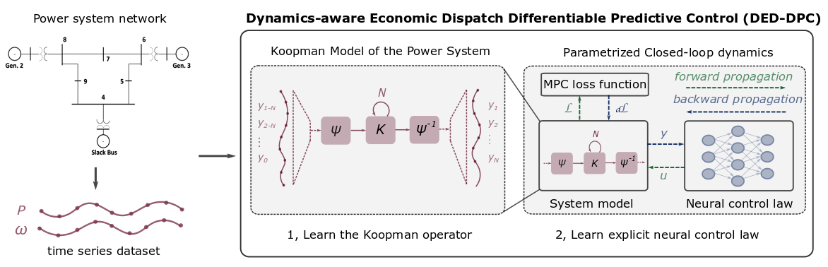
Learning to Control Power System
Benefits of Scientific Machine Learning-based Digital Twins
Fast prototyping by re-using code template from building control project.
Real-time decisions are made orders of magnitude faster than traditional model-based approaches.
Ethan King, et al., Koopman-based Differentiable Predictive Control for the Dynamics-Aware Economic Dispatch Problem, American Control Conference 2022

Slide 26
Summary
Scientific machine learning (SciML) methods integrating deep learning, constrained optimization, physics-based modeling, and control
Learning to optimize (L2O)
Learning to control (L2C)
Learning to model (L2M)
Learning to solve (L2S)
Energy systems applications
Buildings
Power systems
Wind farms
Energy storage
Transportation networks
drgona.github.io
jdrgona1@jh.edu

Slide 27
















Acknowledgements
Aaron Tuor
James Koch
Madelyn Shapiro
Bruno Jacob
Rahul Birmiwal
Ethan King
Sonja Glavaski
Sayak Mukherjee
Wenceslao Shaw Cortez
Soumya Vasisht
Shrirang Abhyankar
Mahantesh Halappanavar
Panos Stinis
Draguna Vrabie

Slide 28
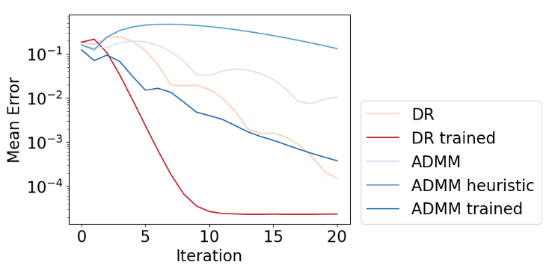
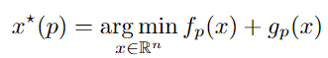


Metric Learning to Accelerate Convergence of Operator Splitting Methods
Parametric programming setting:
Douglas-Rachford splitting (DR) algorithm:
We can accelerate convergence of DR and ADMM algorithms via end-to-end metric learning.
Idea: Train neural network to optimize the metric as a function of problem parameters:
Ethan King, James Kotary, Ferdinando Fioretto, Jan Drgona, Metric Learning to Accelerate Convergence of Operator Splitting Methods for Differentiable Parametric Programming, Under review for CDC 2024.

Slide 29


Metric Learning is a Form of Active Set Prediction
Ethan King, James Kotary, Ferdinando Fioretto, Jan Drgona, Metric Learning to Accelerate Convergence of Operator Splitting Methods for Differentiable Parametric Programming, Under review for CDC 2024.

Slide 30



Neural Differential Algebraic Equations
Trained with physics-informed loss function:
Time stepper architecture is inspired by Lie-Trotter operator splitting method:
Inverse modeling, robustness to noise and, out of distribution generalization.
J. Koch, M. Shapiro, H. Sharma, D. Vrabie, J. Drgona, Neural Differential Algebraic Equations, arXiv:2403.12938, 2024.

Slide 31



Networked Dynamical Systems via Universal Differential Equations (UDEs)
Network of unknown oscillators
Coupling adjacency
Generalization of learned dynamics on never-seen network topology.
Ground truth Kuramoto system:
James Koch, et al., Structural Inference of Networked Dynamical Systems with Universal Differential Equations, Chaos: An interdisciplinary Journal of Nonlinear Science, doi.org/10.1063/5.0109093, 2023

Slide 32



Learning Stable Policies with Neural Lyapunov Functions
Sayak Mukherjee, Ján Drgoňa, Aaron Tuor, Mahantesh Halappanavar, Draguna Vrabie, Neural Lyapunov Differentiable Predictive Control, Conference on Decision and Control (CDC), 2022

Slide 33




Learning Safe Policies with Control Barrier Functions
Wenceslao Shaw Cortez, et al., Differentiable Predictive Control with Safety Guarantees: A Control Barrier Function Approach, Conference on Decision and Control (CDC), 2022

Slide 34

Differentiable Parametric Programming: Generalization of Physics-informed Neural Networks
Problem formulation:

Slide 35
Differentiable Parametric Programming: Generalization of Physics-informed Neural Networks
Objective function
Problem formulation:
Constraints
Primal optimizers
Scenarios
Solution map
Parameters

Slide 36

Differentiable Parametric Programming: Generalization of Physics-informed Neural Networks
Objective function
Problem formulation:
Constraints
Primal optimizers
Scenarios
Solution map
Parameters
Lagrangian form:
Constraints penalties
Gradient-based optimization

